Slide 1

ME 203 Introduction to MS Excel Lecture 2

Slide 2
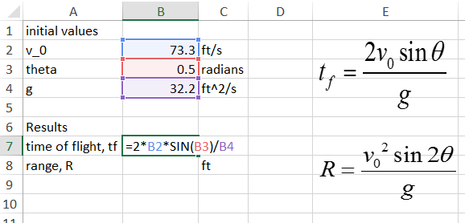
Naming Variables
Using cell references in formulas can make them difficult to read and debug
Use variable names to make formulas easily readable

Slide 3
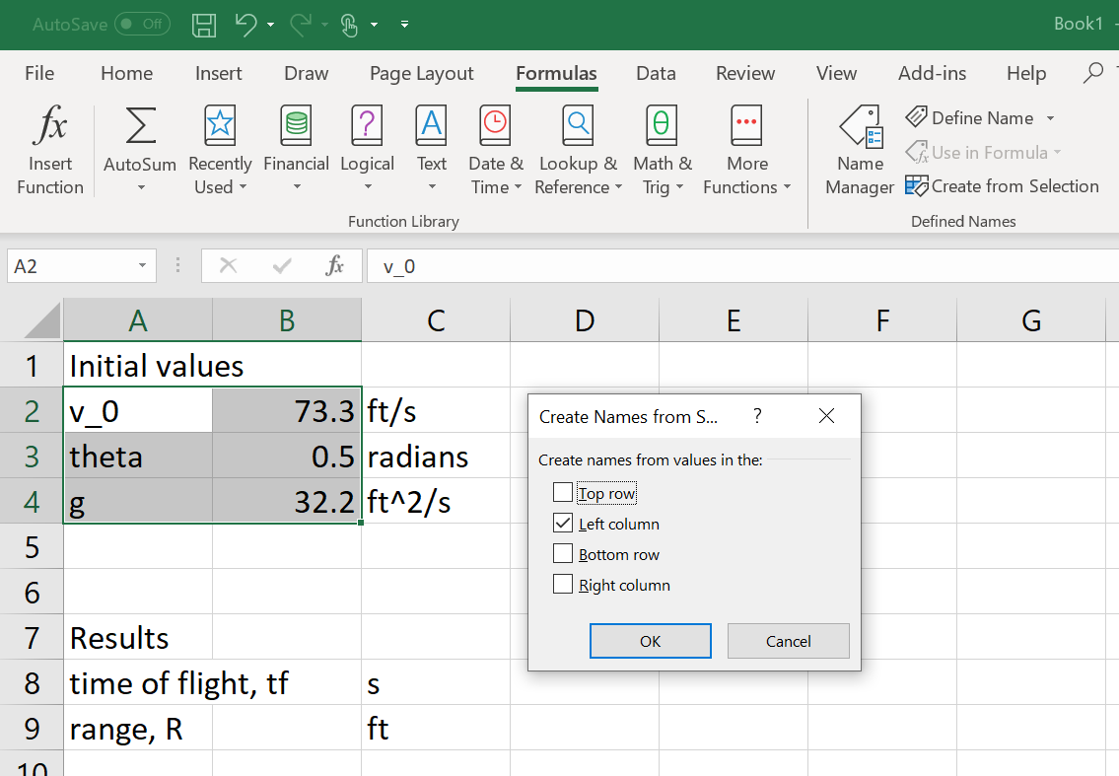
Naming Variables
2. Create named cells
1. Highlight cells with variable names and values
3. Check the location of variable names. In this case they are in the left column of the highlighted cells

Slide 4
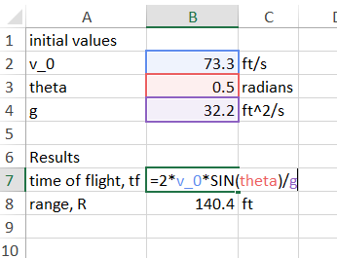
Naming Variables
Variable names can be used in formula

Slide 5
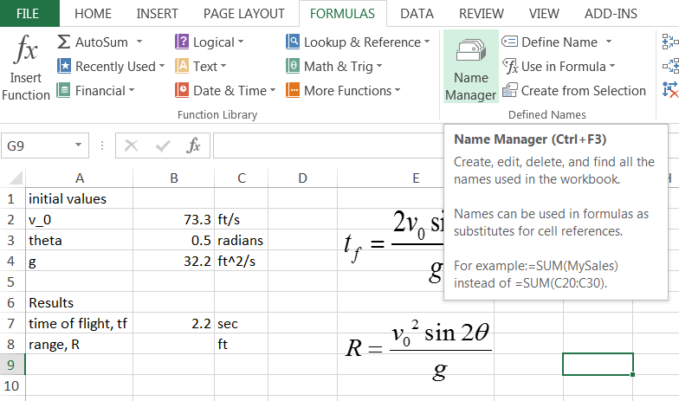
Naming Variables
Variable names can be used in formula

Slide 6
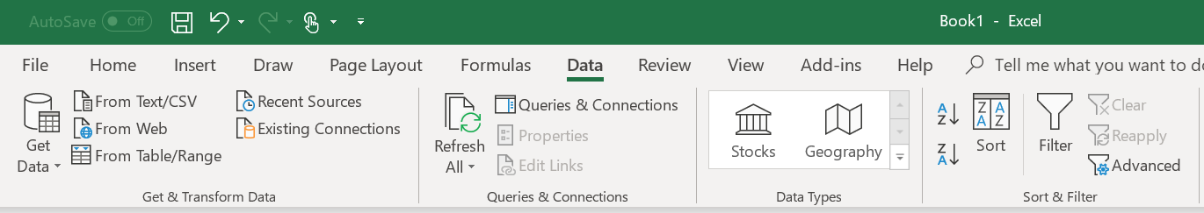
Import Data
Often you will collect data from an experiment and the output is in another format (i.e. txt file)
To make calculations in EXCEL the data needs to be imported
Data>From Text (will import txt file)

Slide 7
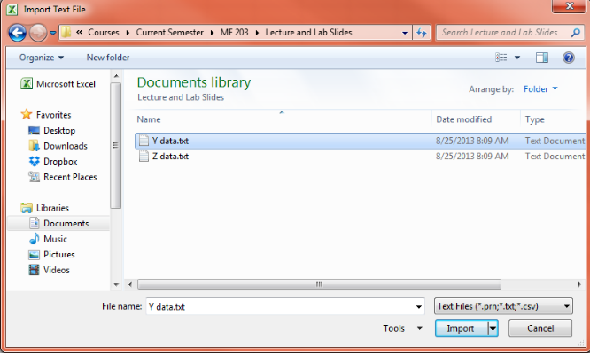
Import Data
Navigate to the file you want to import
Click on the file and click import

Slide 8
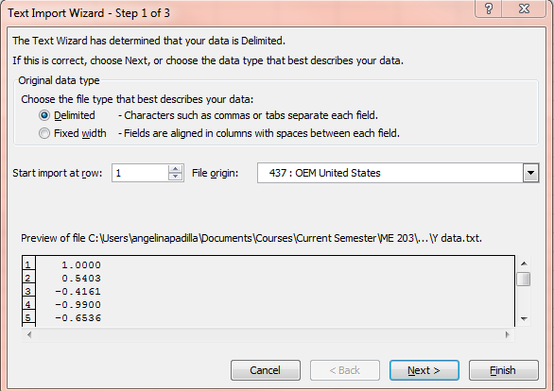
Import Data
Choose data format of the text file
Choose the first row of the text file to import
Click Next

Slide 9
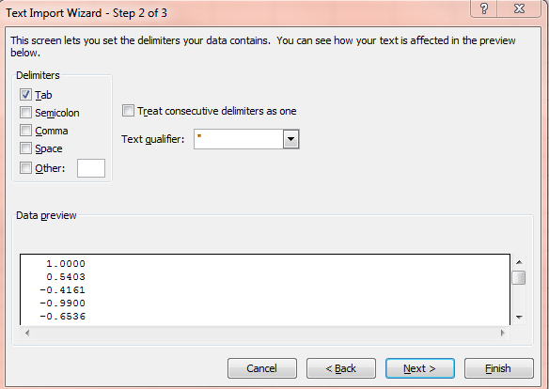
Import Data
Choose how the data points are separated
Click Next

Slide 10
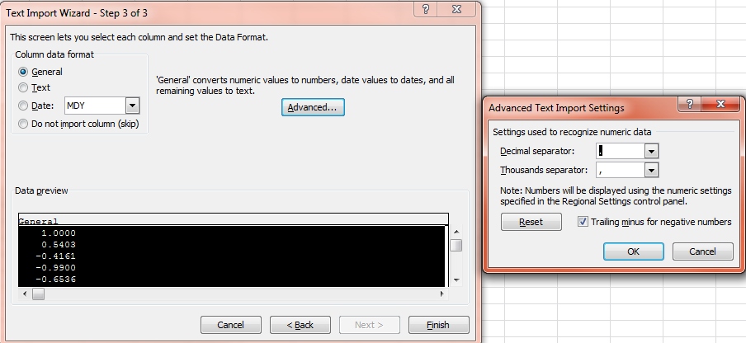
Import Data
Choose how the data is formatted
Advanced…(choose separator notation)
Click Finish

Slide 11
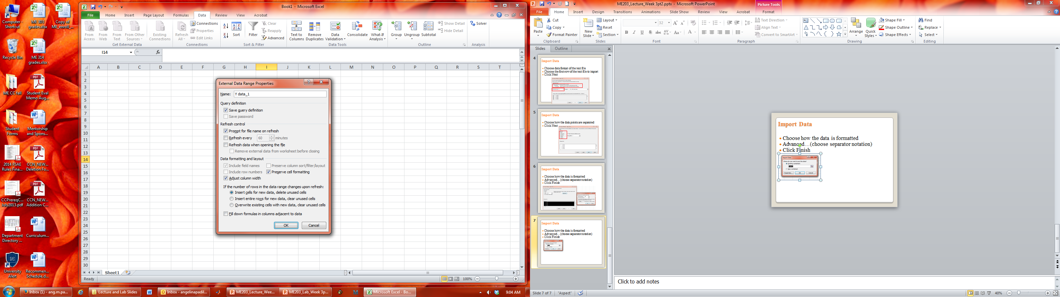
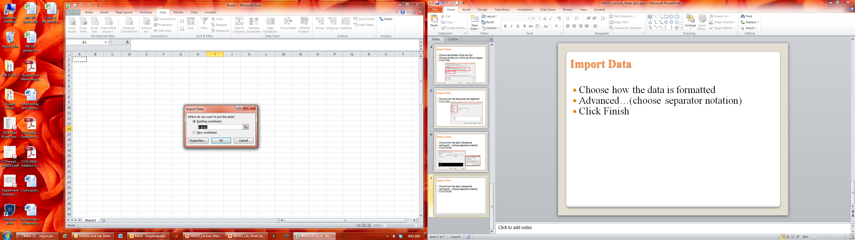
Import Data
Choose where to put the data
Properties…(choose how the data gets inserted)
Click Ok

Slide 12
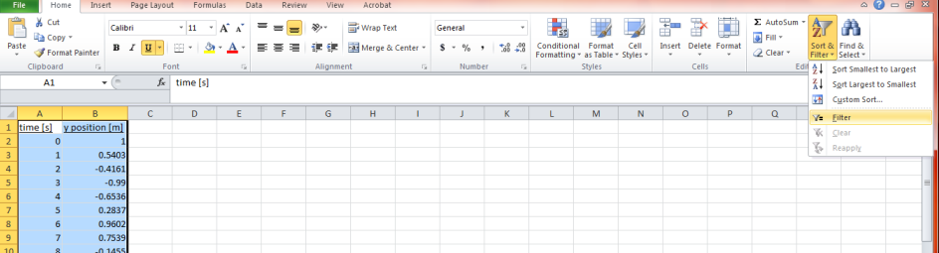
Sort and Filter
Sort
Reorders the data
Highlighting multiple columns sorts data is first column and moves the data in the other columns so the entire row moves
Filter
Only displays data that meets specified criteria

Slide 13
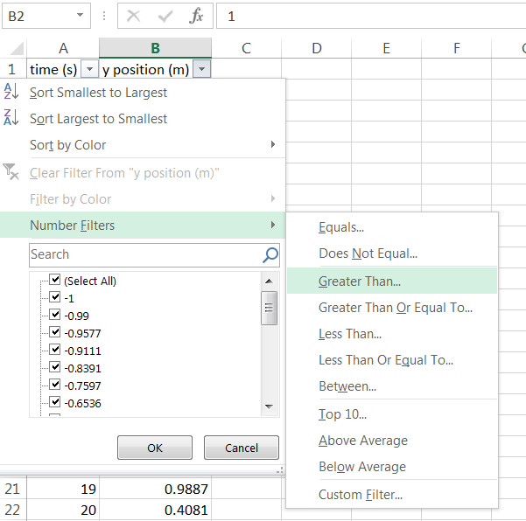
Filter
Sort and Filter>Filter - Arrow will appear at the top of the column
Click on arrow to choose filter type (e.g. greater than)
Click on arrow

Slide 14
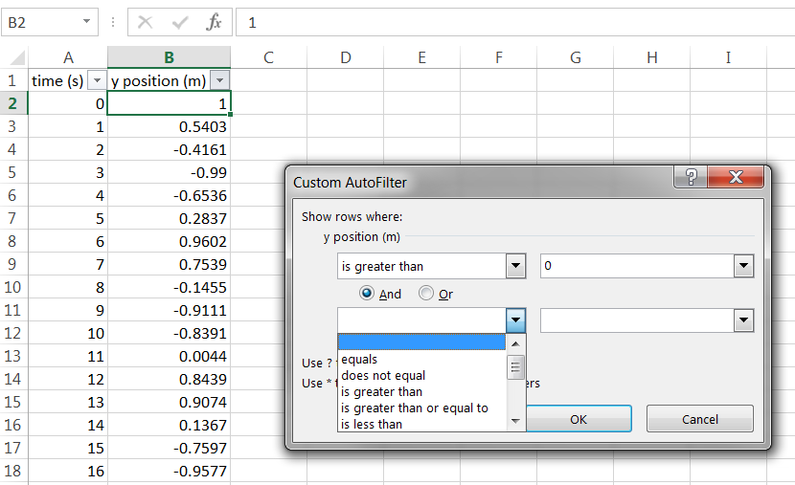
Filter
If we want only positive values – put zero in for the number
Allows you to scroll through data values
Allows you to specify multiple conditions

Slide 15
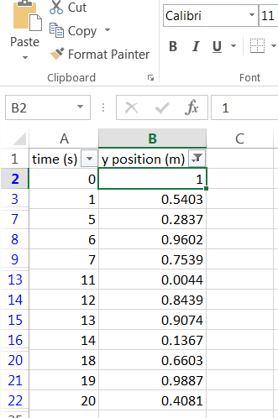
Filter
Data that meets the criteria is visible and data that does not meet the criteria is hidden
To remove the filter and see all of the data click on the arrow and clear the filter

Slide 16
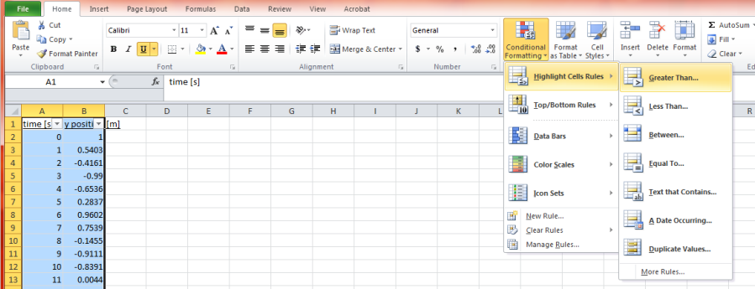
Conditional Formatting
If you don’t want to hide the cells you can use conditional formatting to highlight the positive values instead

Slide 17
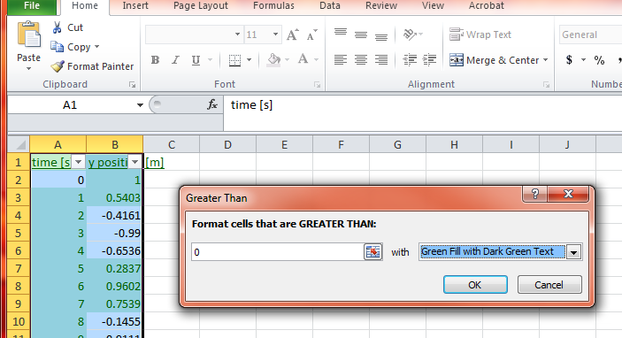
Conditional Formatting
If you don’t want to hide the cells you can use conditional formatting to highlight the positive values instead
Specify the number and the cell format

Slide 18
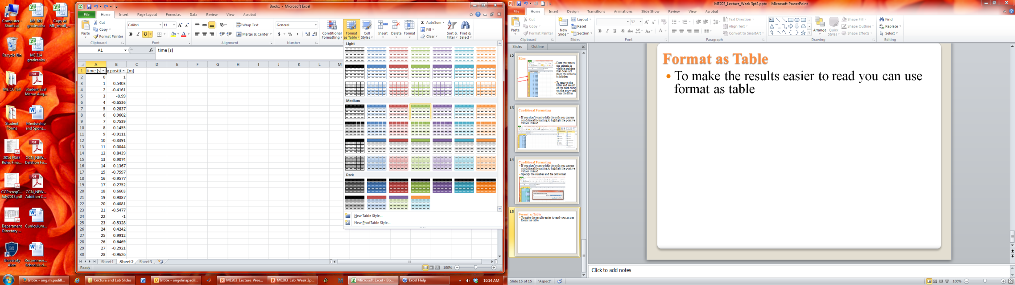
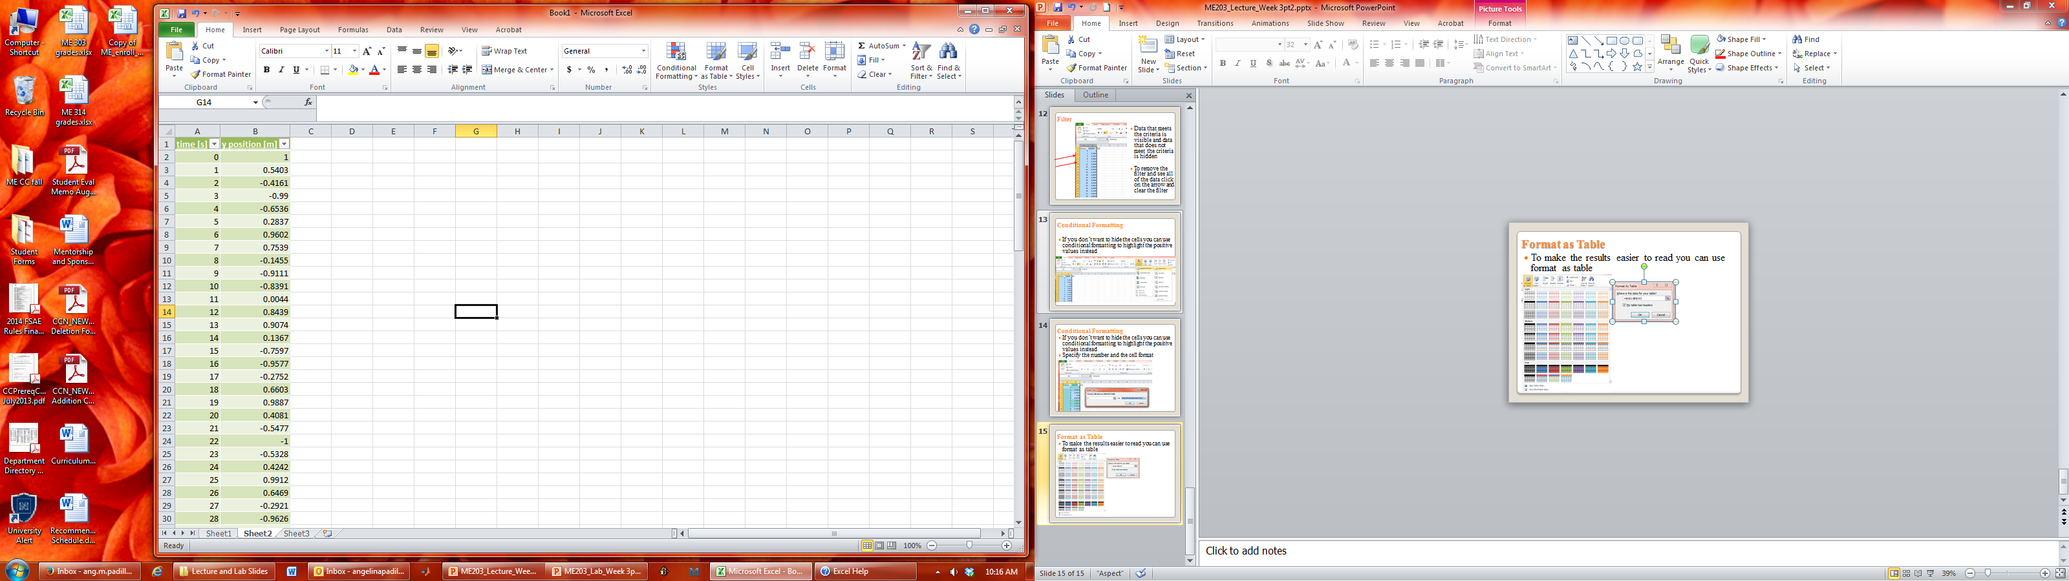
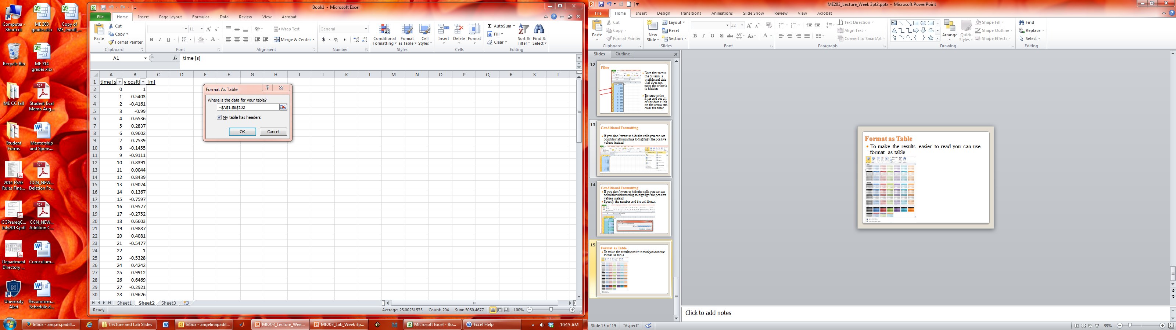
Format as Table
To make the results easier to read you can use format as table

Slide 19
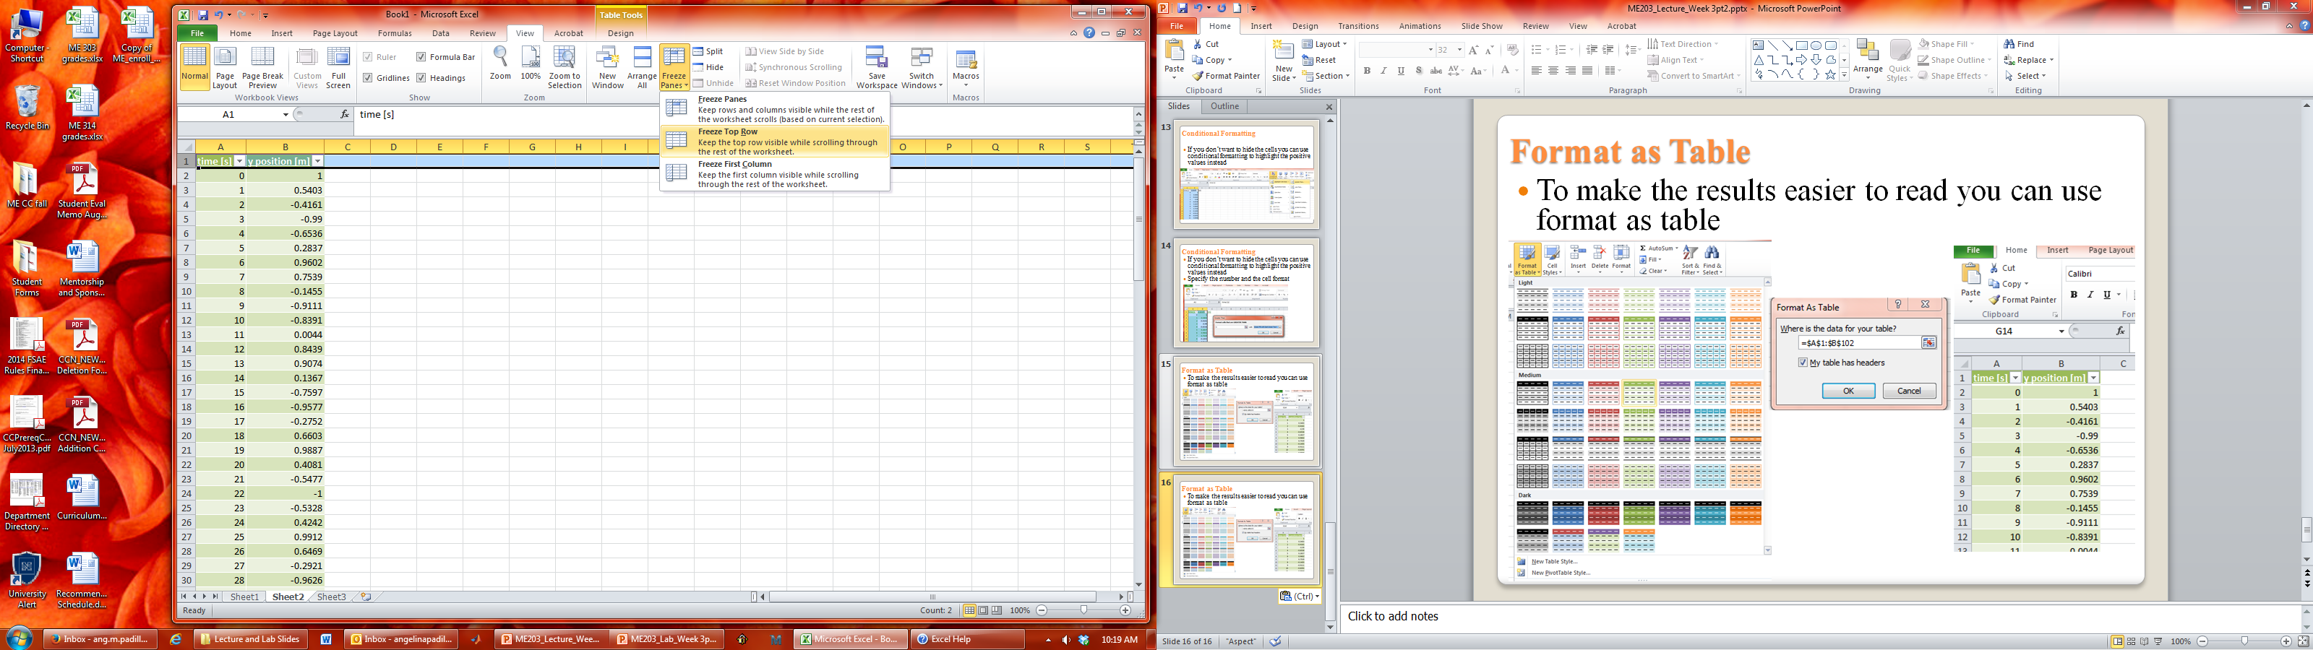
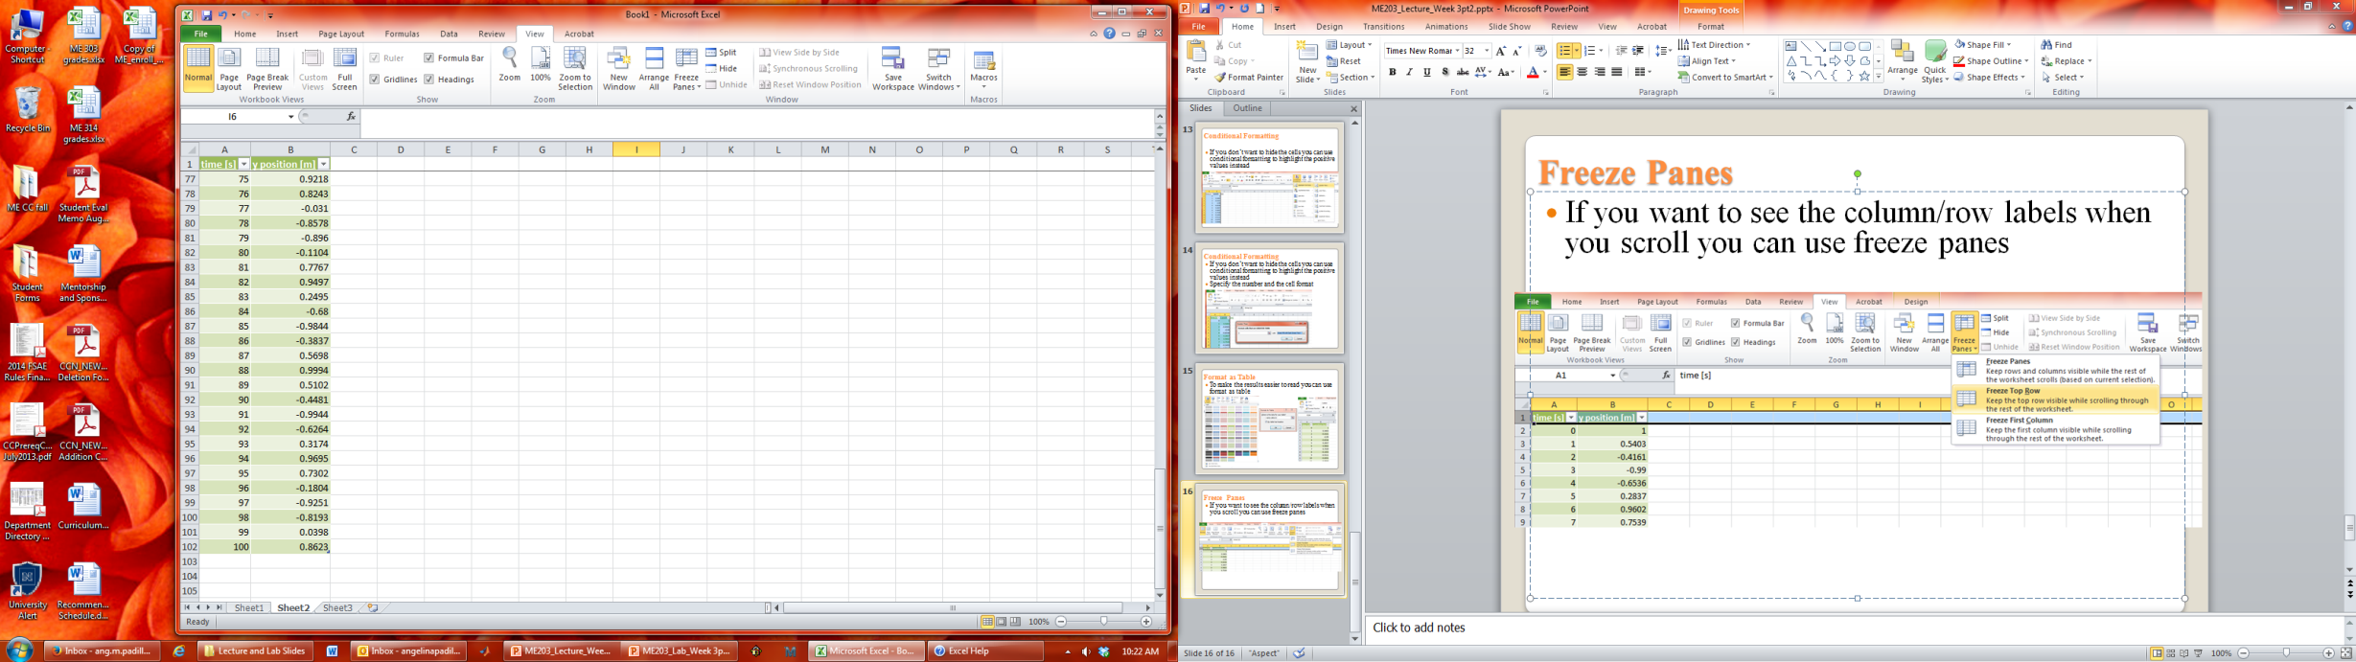
Freeze Panes
If you want to see the column/row labels when you scroll you can use freeze panes
View>Freeze Panes
Notice: First row does not change when scrolling

